Slide 1

BNVirt
Bare Metal Network Virtualization
Notes:
Good Afternoon Everyone, I am Pravein , and Ahmad here
And we introduce BNVirt, a Bare-metal network virtualization product for cloud computing

Slide 2

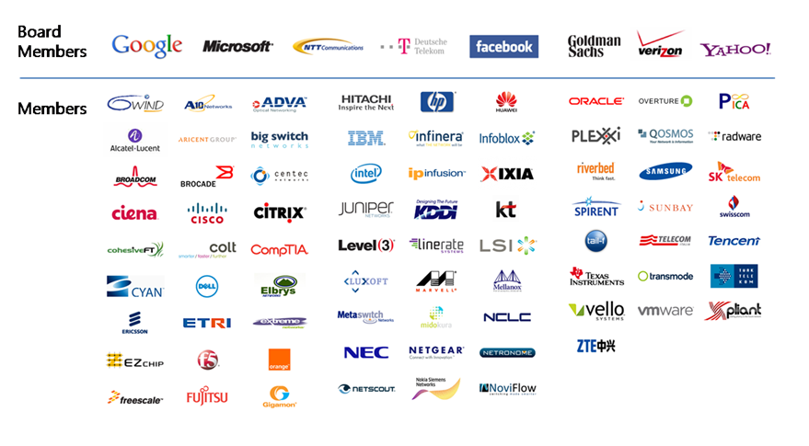
Software Defined Networking
Is
Happening!!
Notes:
With the recent turn of events, verizon has announced shift to SDN, and many of the top telcos are also moving towards SDN.
Infact, The shift to SDN to so strong with ONF with major companies on board.
And Hence, SDN is happening!!

Slide 3













Notes:
There are variety of cloud services which provide isolated environments to tenants
.And the tenants may want to have SDN in their network with this paradigm shift.

Slide 4


Tenant 1
Tenant 2
Tenant 3
OpenDaylight Controller
ONOS Controller
POX Controller
OpenFlow
Existing SDN Network Hypervisors
OpenFlow
Switch1
Switch2
Notes:
However, if you look at the current products that caternetwork virtualization in SDN have major drawbacks:
1) Cannot scale to big topologies/ random topologies.
2) Cannot

Slide 5

Tenant 1 (DC)
Tenant 2 (Random)
Tenant 3 (WAN)
POX Controller
OpenDaylight Controller
ONOS Controller
Guarantee Isolation/
Sandbox
Virtual Topology
BNVirt
2) Flexible Hardware accelerated
Topologies with
bare-metal switching
(Suitable for ISPs/DCs)
Tenant Mapping
3) Low Cost and
Easy to provision.
Switch1
Switch2

Slide 6



Prototype
Implemented on top of
Integrated with a Bare-metal provisioning service.
Deployed on NCL Staging environment.
Able to virtualize topologies with 13 switch with just one physical switch

Slide 7

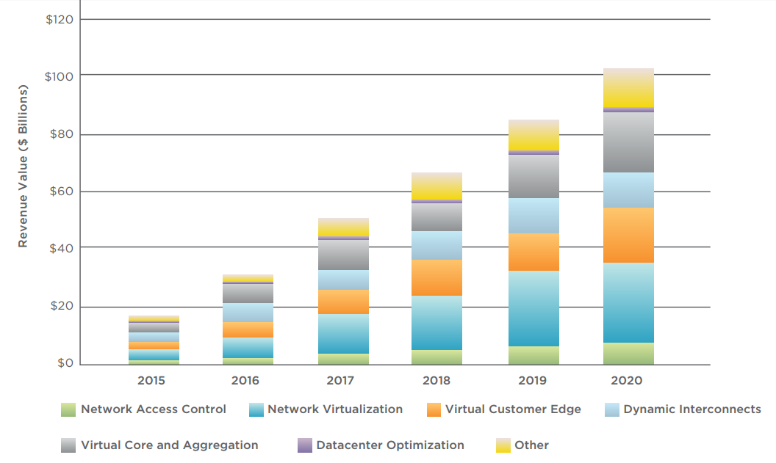
Network Virtualization Market
$28 Billion by 2020
Source : SDXCentral Market Size report 2015

Slide 8
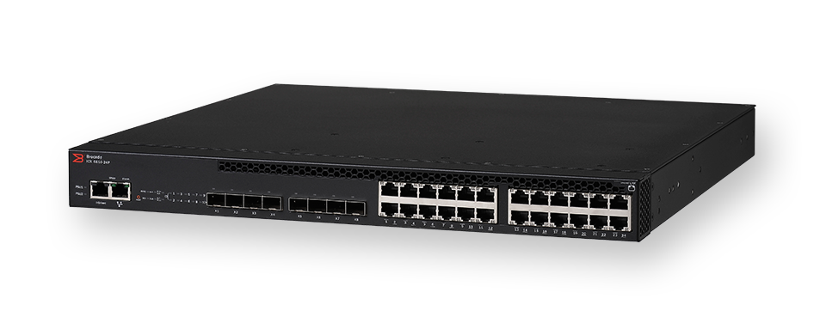
Fund Usage
10,000 SGD
- Two off the shelf SDN switches.
- UI/UX design for the provisioning service.

Slide 9



Milestones
Step 1
Demo Showcasing
(Strategic Partnerships)
October 2017 onwards
Integration with OpenStack
June 2017 – September 2017
Switch Procurement
May 2017 – June 2017

Slide 10


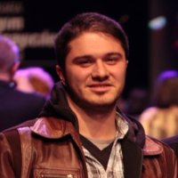
Pravein Govindan Kannan
Ahmad SOLTANI
Ph.D. Candidate
Software Defined Networking
Ph.D. Candidate
Software Defined Networking, Security

